Slide 1
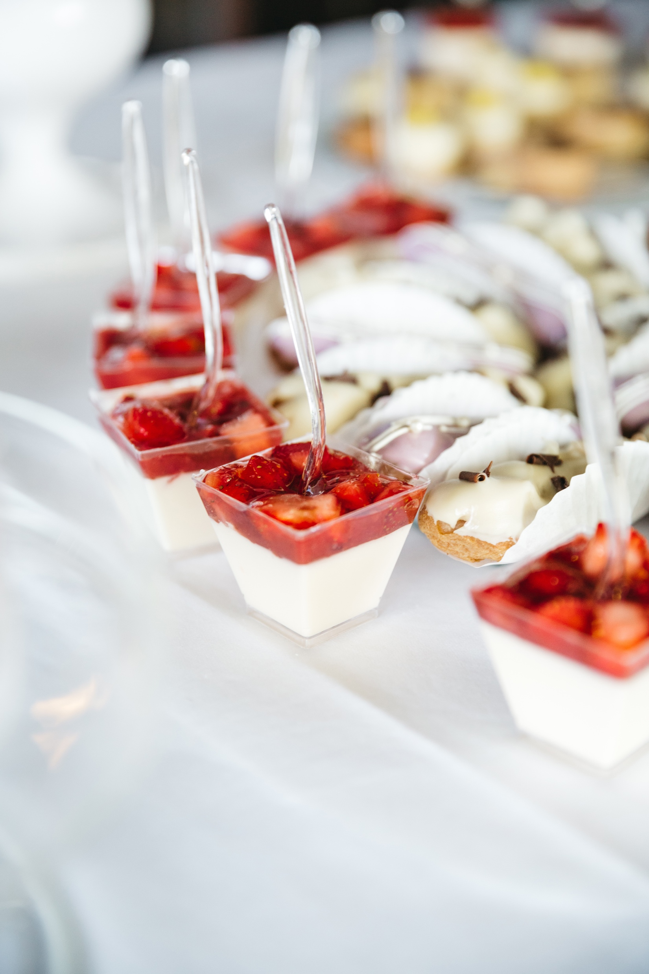
HOSPITALITY & EVENTS
Catering Brochure
Introduction
Welcome to the MUFG Hospitality Department. We are committed to delivering a consistently high standard of hospitality catering, where food quality and service excellence go hand in hand. Our team provides a prompt, discreet, and professional service to ensure every experience meets the standards you expect.
To support the smooth delivery of your event, this hospitality brochure outlines the range of services available. We would be pleased to meet with you to discuss any aspect of your catering requirements.
Should you have any specific requests or dietary requirements, we will always do our best to accommodate them.

Slide 2
Contact
To make a hospitality booking, please use the Condeco system. For food orders or any special requests, contact the Event Manager, Laura Moorcroft (laura.moorcroft@mufgsecurities.com), or Reception directly at reception@uk.mufg.jp.
Please note that a minimum of 96 hours’ notice is required for all bookings. Fine dining and canapé functions require an additional 48 hours’ notice. A strict 48-hour cancellation policy applies to all hospitality bookings.
Functions and Events
All prices quoted apply to functions held during normal working hours (7:00am – 3:30pm, Monday to Friday).
For events taking place outside these hours, additional labour charges will apply alongside your food selection. These charges are indicative and will vary depending on event start and finish times. All functions must conclude by 8:00pm, with last drinks served at 7:30pm.
Drinks Functions (No Food)
Two staff for set-up, service, and clear-down – £260 (up to 75 guests), up to 7:30pm.
Three staff for set-up, service, and clear-down – £370 (75–125 guests), up to 7:30pm
Drinks Functions with Canapés
Three staff for set-up, service, and clear-down, plus one chef – £550 (up to 75 guests), up to 7:30pm.
Five staff for set-up, service, and clear-down, plus one chef – £790 (75–125 guests), up to 7:30pm.
Notes:
Labour charges are estimated and may vary depending on the duration of the event. Any additional time will be charged accordingly.
All prices listed in this brochure are exclusive of VAT and the management fee (8%).
Any missing or damaged hired equipment will be charged in addition to the final cost.
Special requests, such as large events, may require hired equipment and will incur additional costs. Please contact the event manager directly.

Slide 3
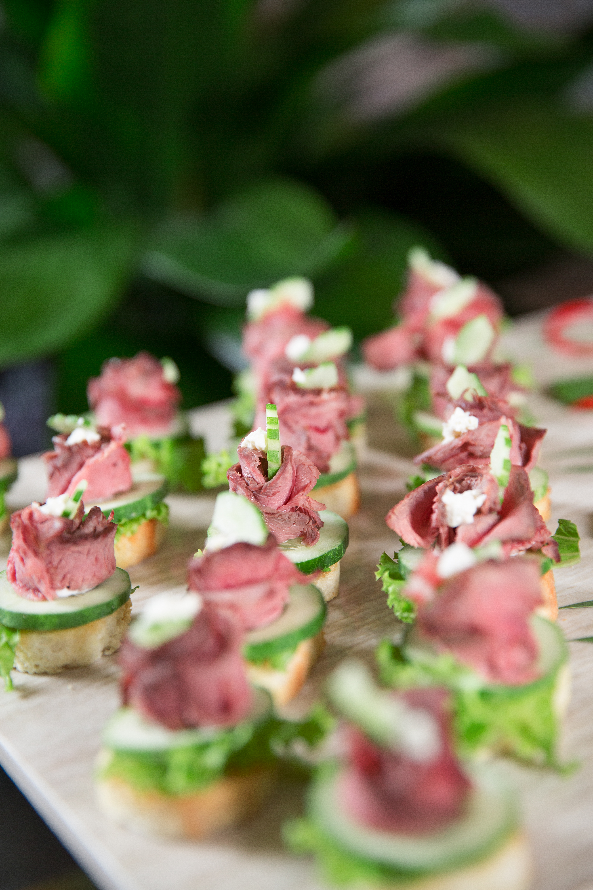
INGREDIENT AND ALLERGEN INFORMATION
For detailed allergen, ingredient, and dietary information, please let us know at the time of booking.
If you need any further support, please contact the Event Manager, Laura Moorcroft, at laura.moorcroft@mufgsecurities.com, or email reception@uk.mufg.jp.

Slide 4
CONTENT
BEVERAGES
BREAKFAST MENU
WRAP & SANDWICH SELECTION
FINGER FOOD
BUDDHA BOWLS
BOXED SALADS
CANAPES
SWEET SELECTION
Sharing platters
wine list & BEERS
ADD ON'S

Slide 5

Beverages
Prices are per person unless otherwise stated.
Hot Beverage Tray – £2.50 Freshly brewed Fairtrade coffee A selection of breakfast and speciality teas A selection of biscuits
Mineral Water
Selection of Canned Soft Drinks – £1.50 Coca-Cola / Diet Coke / Coke Zero
Orange Juice – £3.00 Price per litre
Selection of Premium Canned Drinks – £2.00 San Pellegrino Blood Orange & Limonata
Still & Sparkling Water – £1.10 (price per person)

Slide 6
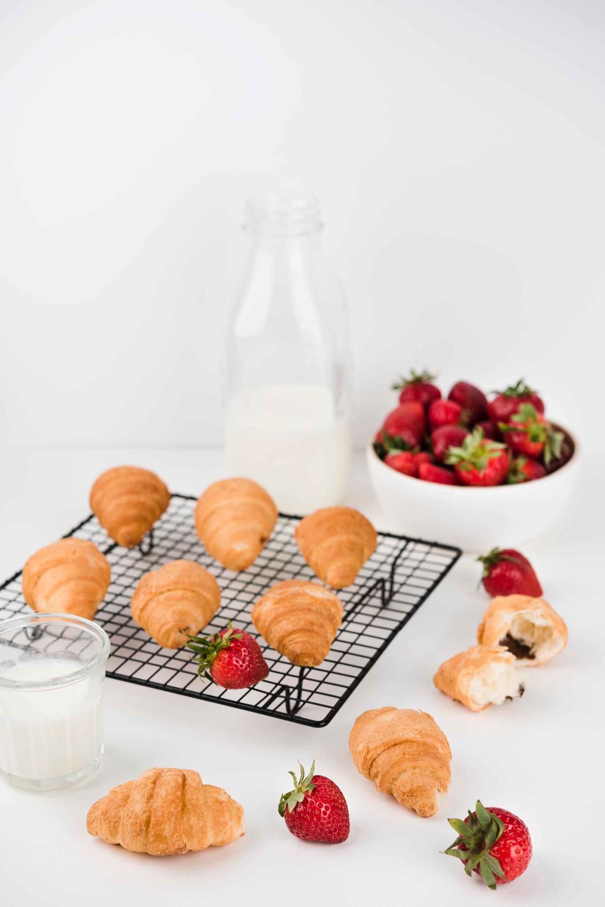
BREAKFAST
Prices are per person (minimum 6 people)
All breakfasts are served with tea, coffee and water.
CONTINENTAL BREAKFAST - £8.50
A selection of mini freshly baked croissants (1)
A selection of mini freshly baked Danish pastries (1)
Seasonal sliced fresh fruit platter
DELUXE BREAKFAST BAGEL - £13.50
Freshly baked mini croissants (1) A selection of mini Danish pastries (1)
Open mini bagel with breakfast toppings (2) meat & veg Individual seasonal fruit salad pots (1)

Slide 7
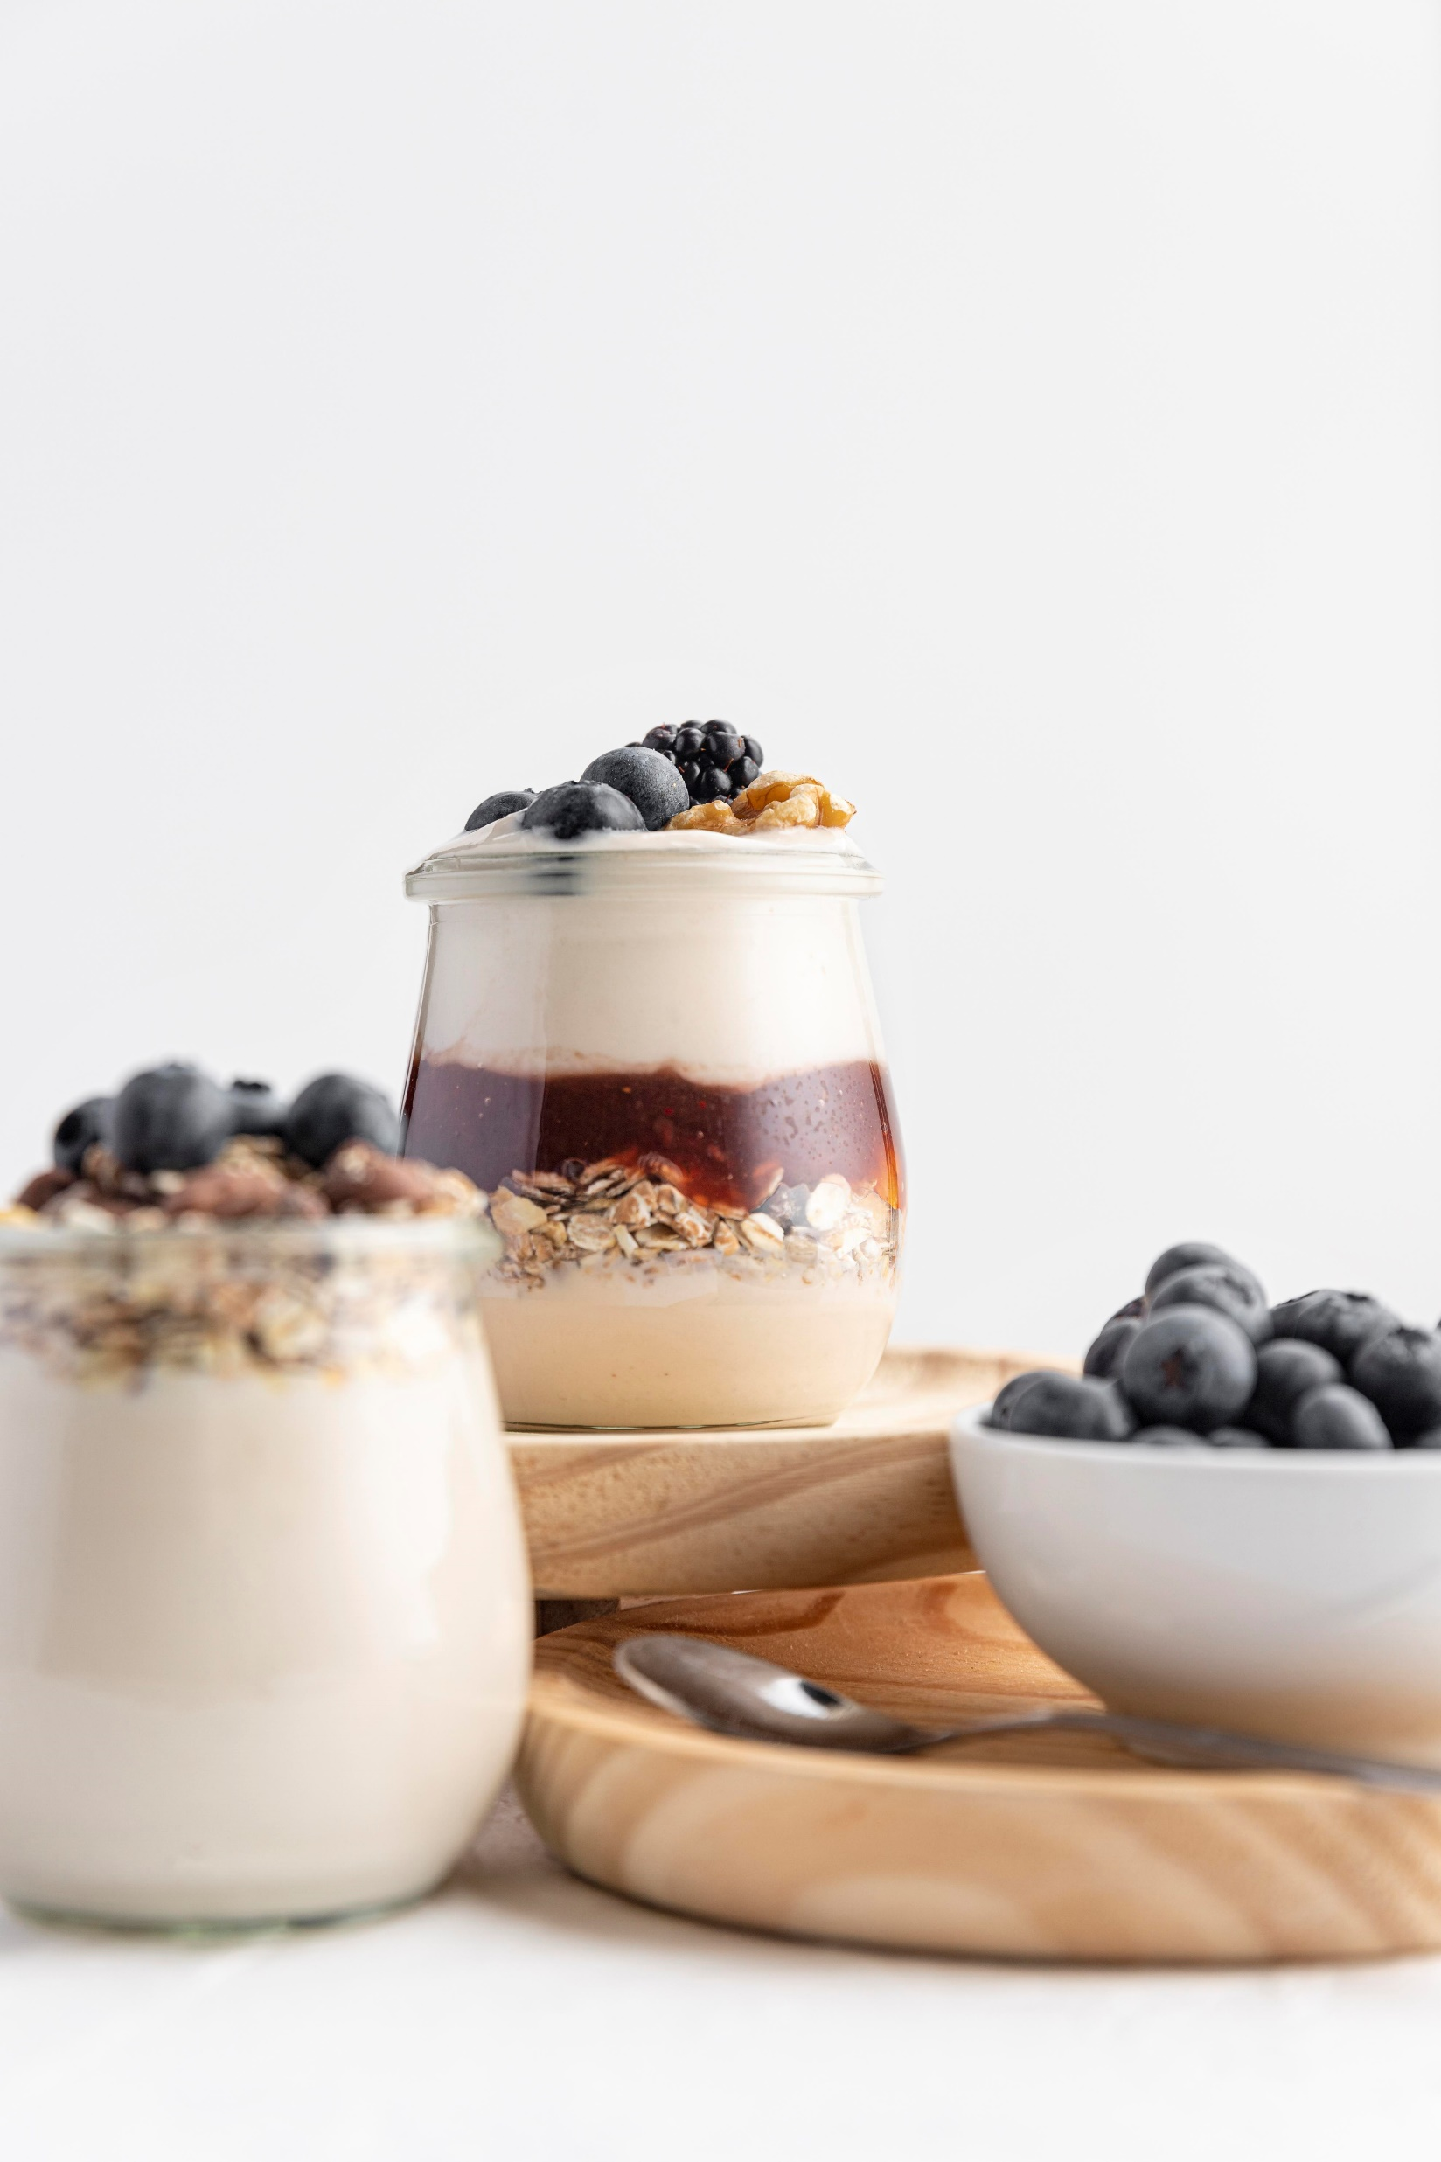
BREAKFAST
SAVOURY BREAKFAST - £13.00
Fresh home-baked large breakfast muffins (1) Large croissants filled with a selection of savoury breakfast fillings (1) Delicious yoghurt with mixed red berries topped with granola (1)
HEALTHY BREAKFAST OPTION - £13.50
Delicious yoghurt with mixed red berries topped with granola (1) Mini open bagel with light cream cheese and cucumber (1) V Bran muffin (1) Homemade fruit smoothie (250ml) (1)

Slide 8
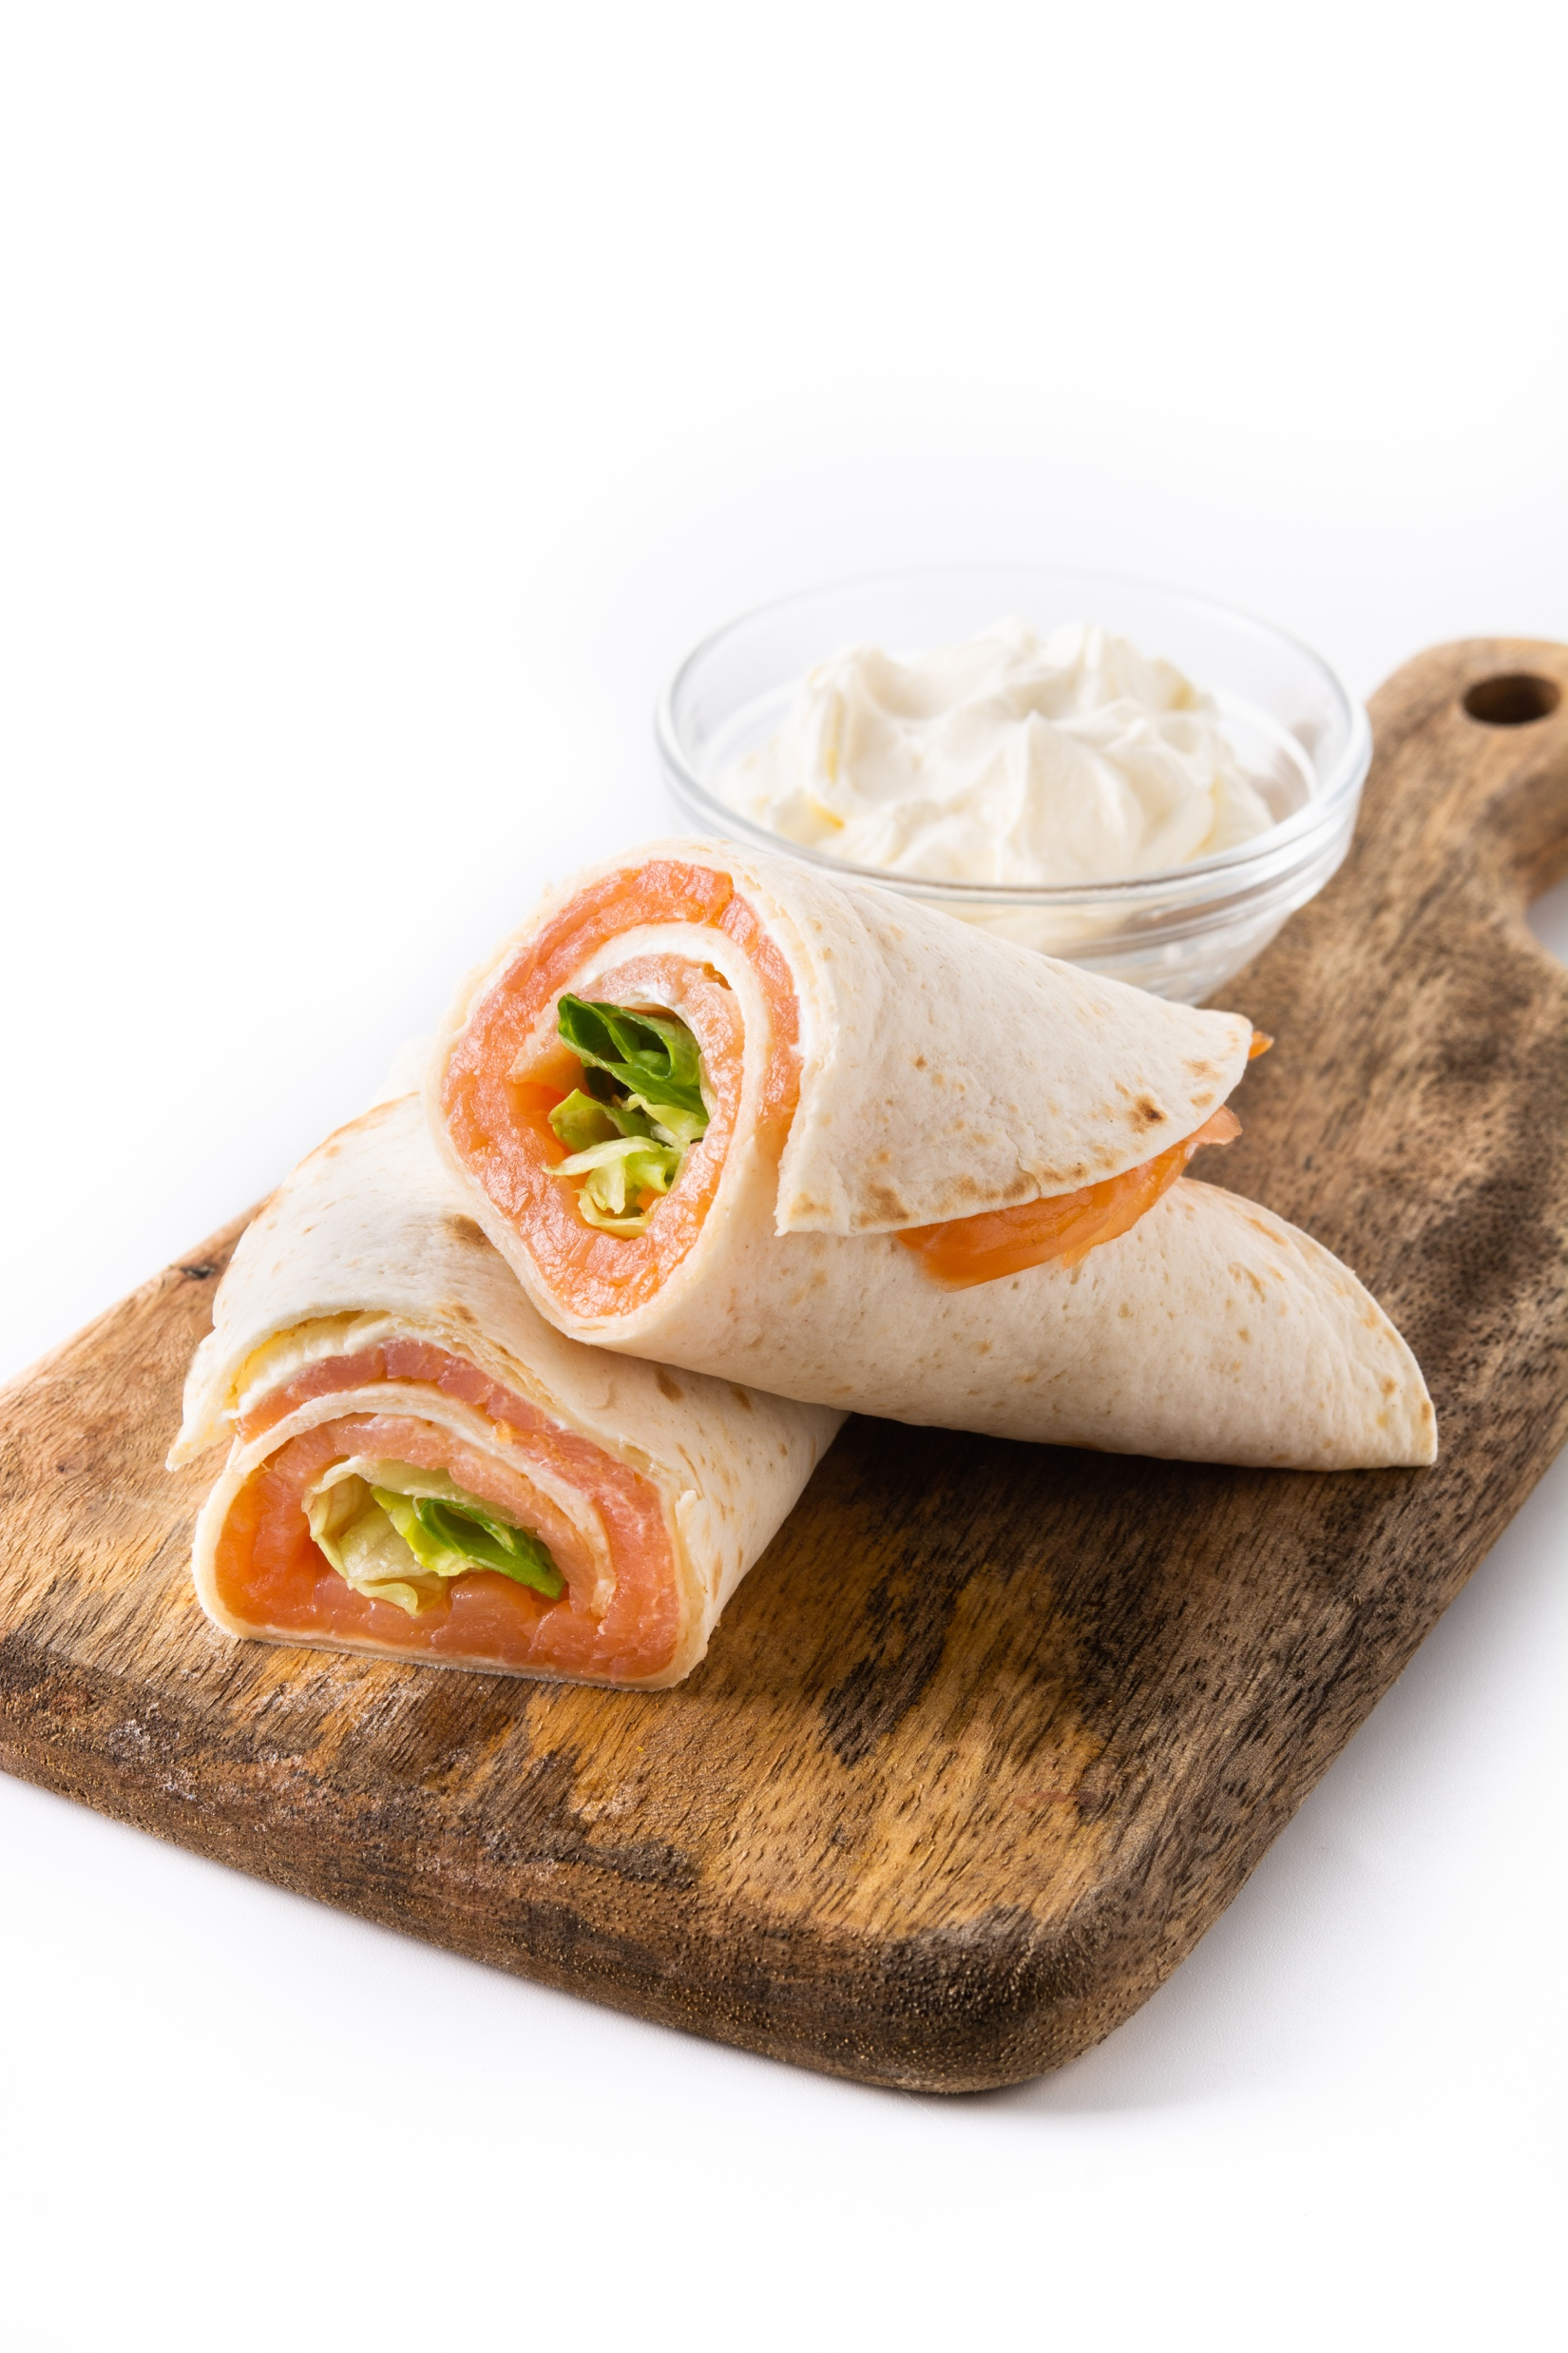
BREAKFAST
FREE FROM BREAKFAST (gluten free, dairy free, vegan) - £13.50
Gluten Free tortilla wrap with avocado, houmous & salad (2) V Soya yoghurt, mixed berries & Gluten Free muesli (1) V Large seasonal fruit skewer (1) V Dairy-free strawberry smoothie made fresh in the morning (1) V

Slide 9
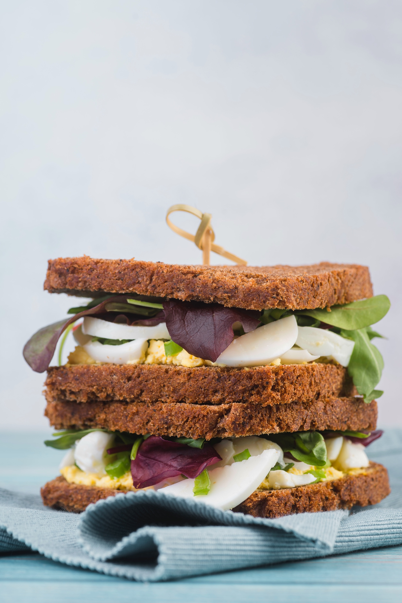
WRAP & SANDWICH SELECTION
Prices are per platter (minimum order for 6 people)
Please add on crisps, drinks and anything extra as prices are now as stated
SANDWICH SELECTION PLATTER
Sandwiches prepared on thick cut wholemeal, malted granary and white sliced bread with a selection of fillings
£56.00 per platter, 6 triangles per person (serves 6)
WRAP SELECTION PLATTER
A selection of generously filled wraps to include – Spinach, tomato and plain wrap fillings
£49.00 per platter, 4 pieces per person (serves 6)
ADD ON'S
Walkers Crisps - £1.10
Canned Drinks - £1.50
Premium Drinks - £2.00
Still & Sparkling Water – £1.10 (price per person)
Sliced Fruit Platter - £5.30 (price per person - minimum order for 6 people)

Slide 10
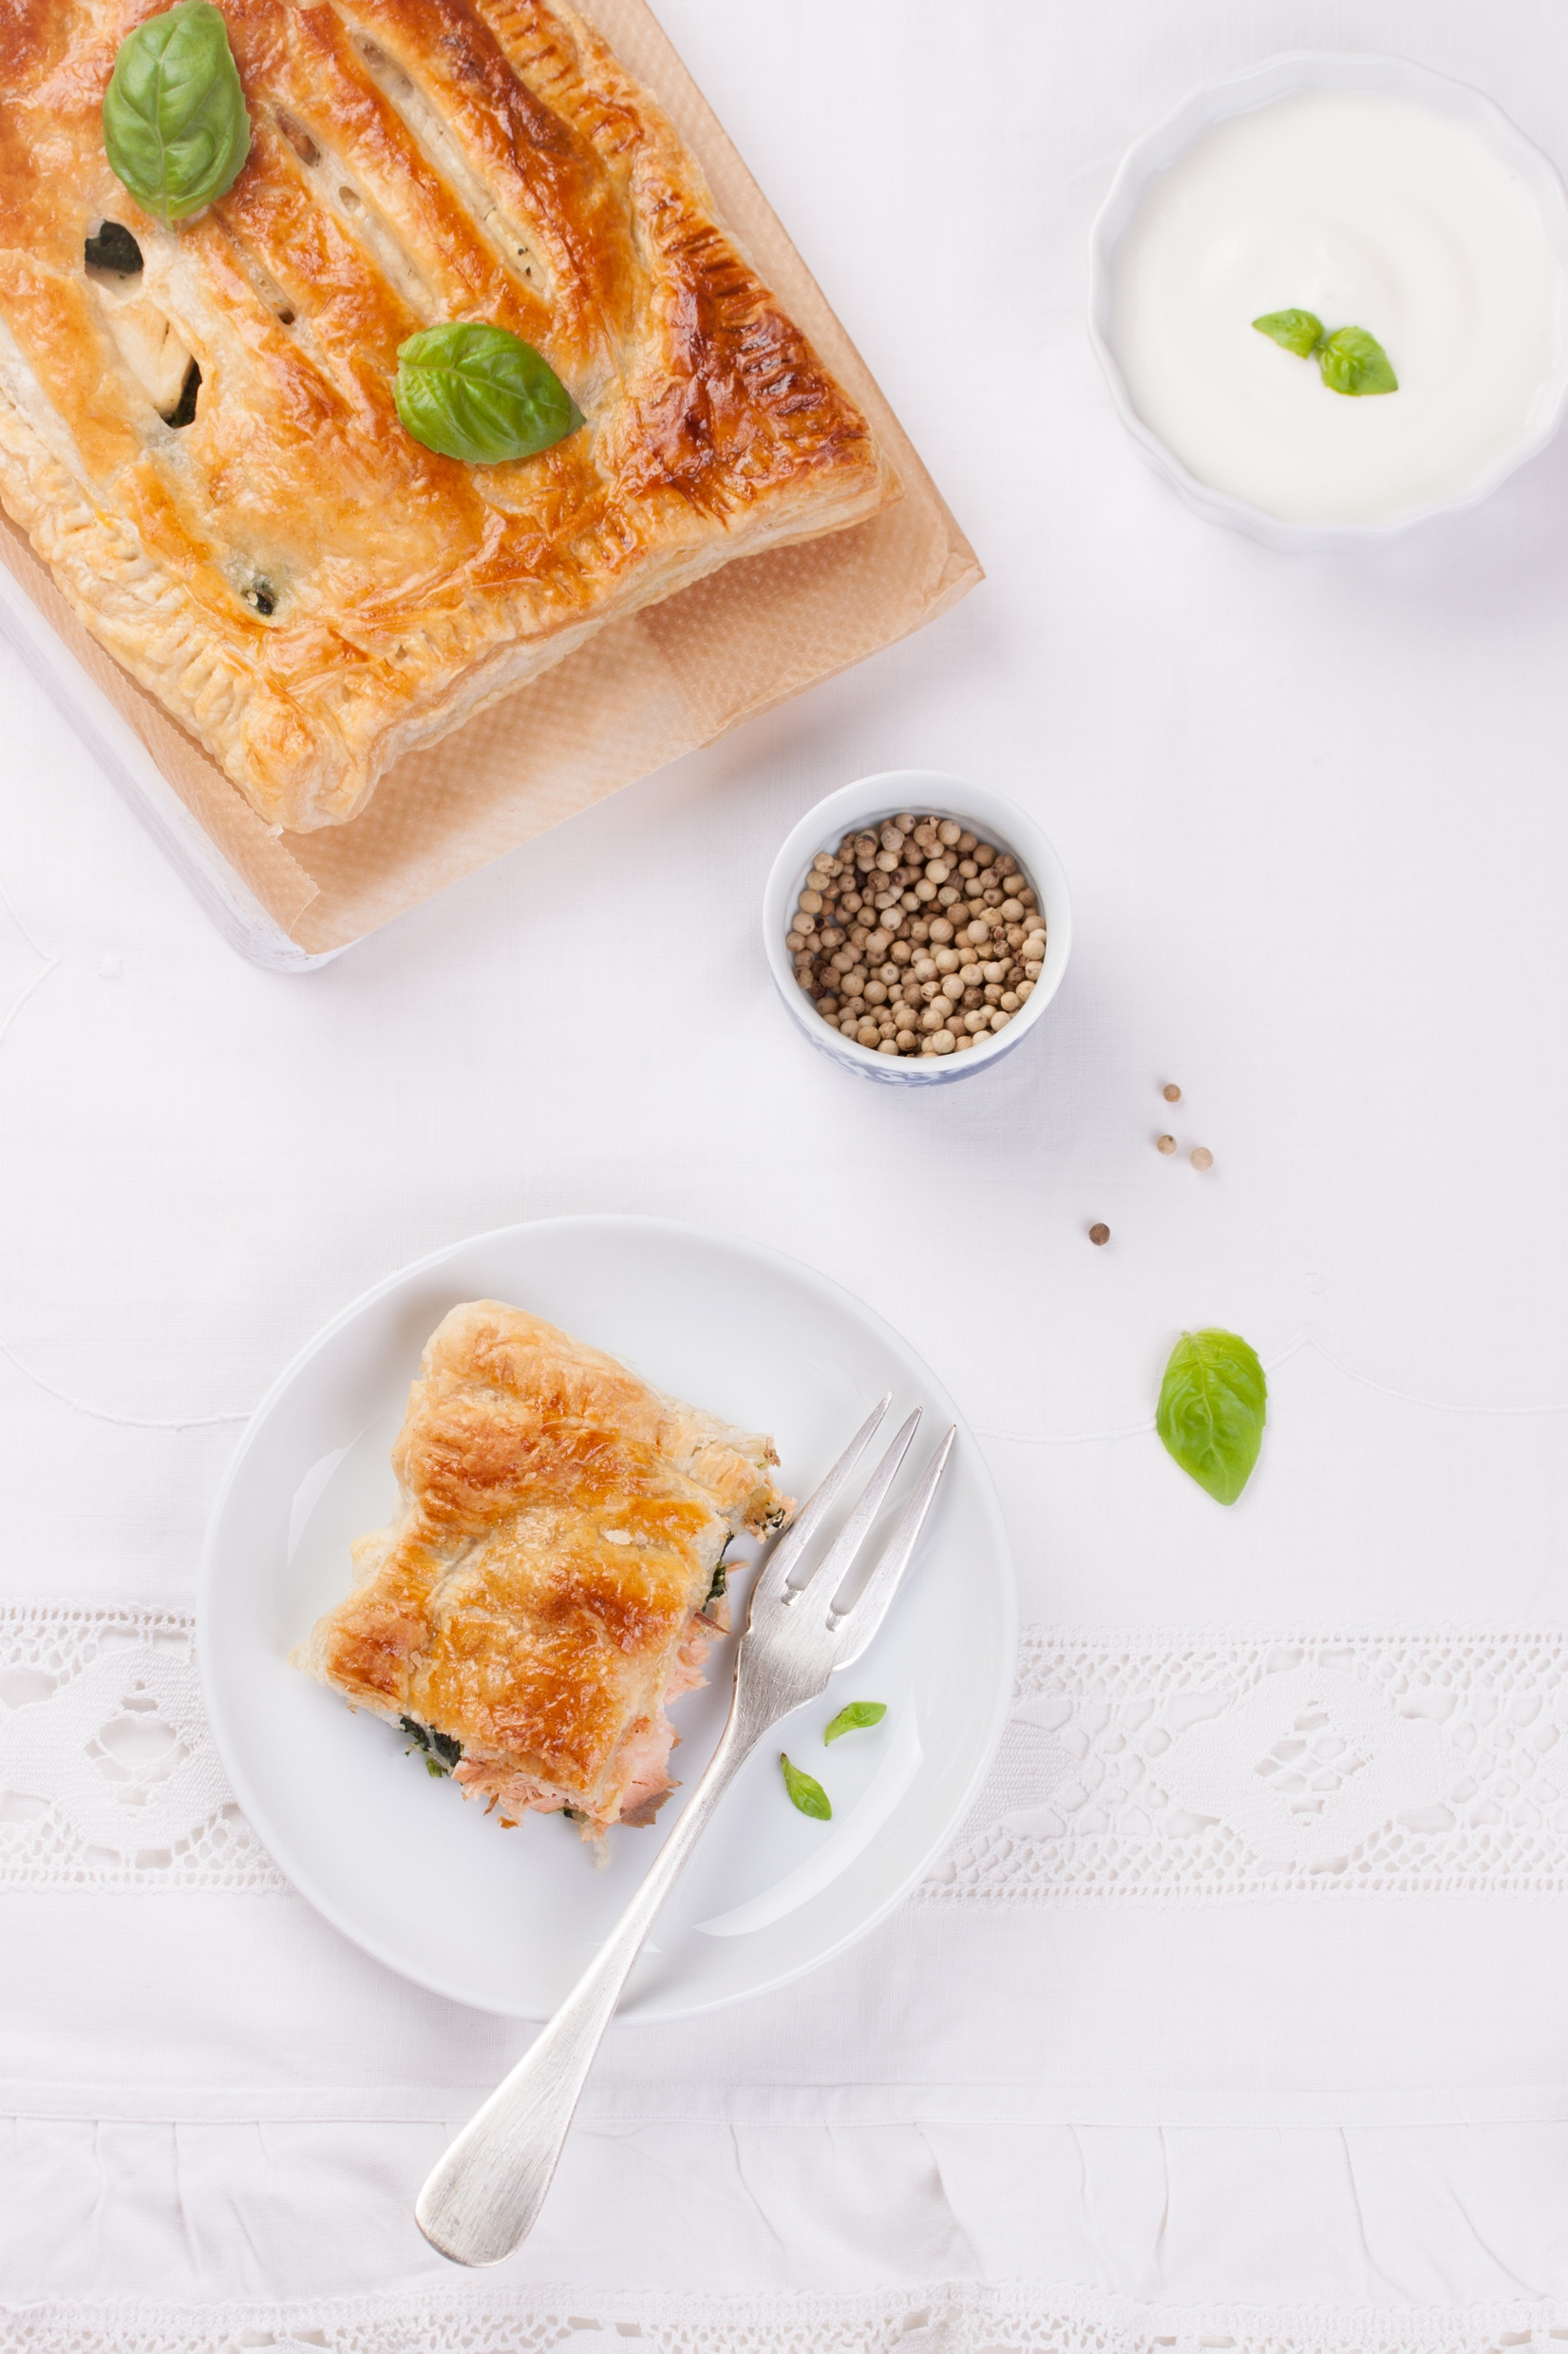
WRAP & SANDWICH – PREMIUM SELECTION
ITALIAN FOCACCIA & CIABATTA PLATTER
Ciabatta, black olive and sun-blushed tomato ciabatta and focaccia breads - filled with the following Italian fillings: Salami and provolone Bresaola Parmesan and rocket Tuna with black olives and peppers Smoked salmon, cream cheese and rocket Tomato basil and mozzarella and avocado Grilled vegetables with pesto
£52.00 per platter, 4 pieces per person (serves 6)

Slide 11
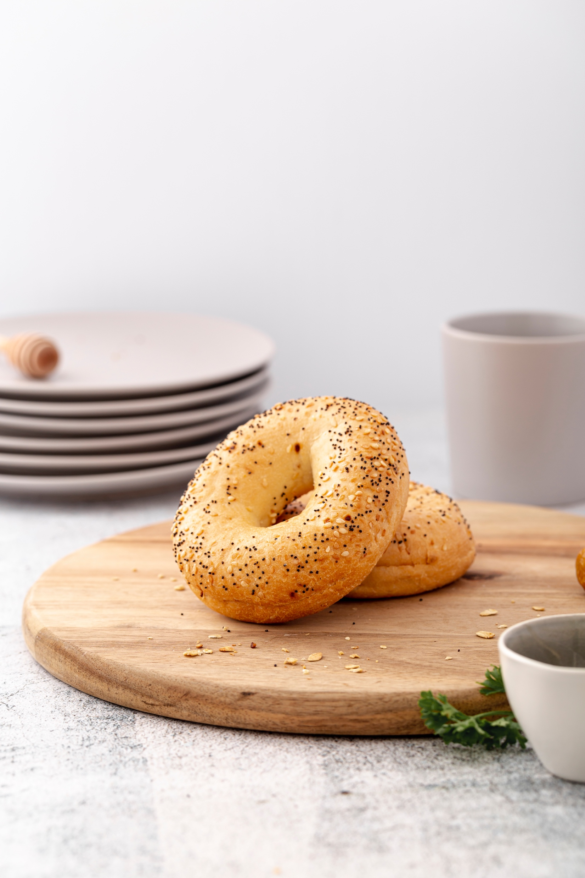
WRAP & SANDWICH – PREMIUM SELECTION
AMERICAN BAGEL PLATTER
Generously filled bagels, a mixture of plain, poppy seed and sesame seeded bagel for the following American fillings: Salt beef, mustard, dill pickle, BLT, Smoked salmon and cream cheese, Crayfish and shrimp mix with baby gem lettuce, Cream cheese and avocado with chilli flakes, Sliced egg, tomato and American mustard mayo
£49.00 per platter, 4 pieces per person (serves 6)

Slide 12
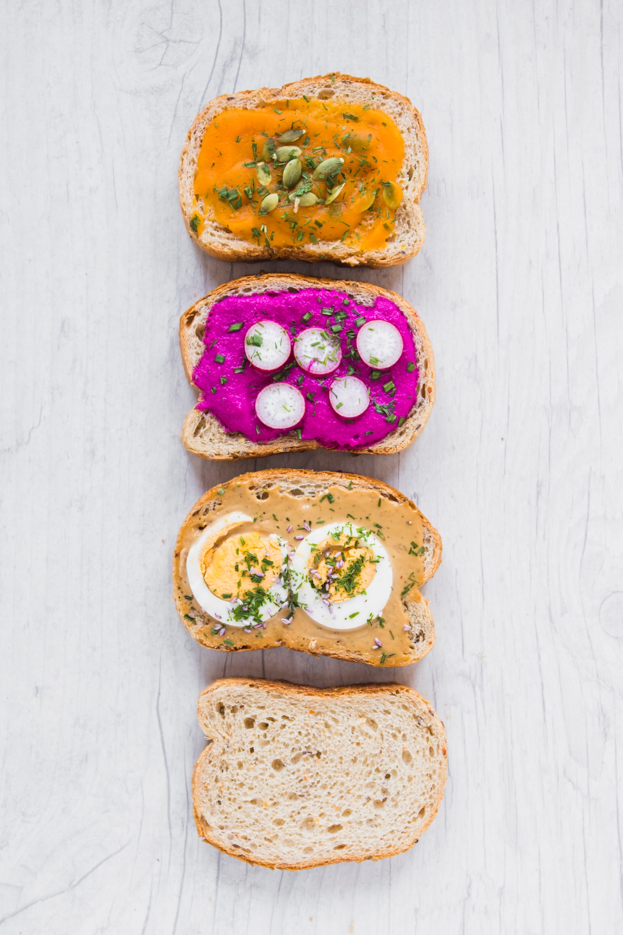
WRAP & SANDWICH – PREMIUM SELECTION
SPECIALITY BREAD SELECTION PLATTER
Generously filled speciality bread to include a selection of the following: sunflower & rye, soft pretzel, quinoa & spelt, beetroot & chia seed
£52.00 per platter, 4 pieces per person (serves 6)
MINI MIXED ROLL SELECTION PLATTER
Delicious small rolls to include a selection of the following: sunflower seed, sesame seed, plain and olive with a selection of fillings
£53.00 per platter, 3 pieces per person (serves 6)
*Special requests as Vegan, Gluten Free or Halal Sandwich, please contact the events team.

Slide 13
FINGER FOOD – 6 PEOPLE MINIMUM
£4.00 per menu item
(the numbers in brackets showing the quantity of finger food per item)
MEAT OPTIONS:
Chicken Gyoza with soy dipping sauce (2)
Duck Pancake Rolls With Chinese Plum Dipping Sauce (2)
Pulled pork Sausage Roll With Kentish Apple Dip (1)
FISH OPTIONS:
Chilli Mango Breadcrumbed Prawn (1)
Mini Crab Cake With Lime Mayonnaise (2)
Ras al Hanout salmon tomato & courgette skewer (1)
VEGETARIAN / VEGAN OPTIONS:
Vegetarian Spring Rolls With Sweet Chilli Dip (2) (Vegan)
Spinach & Potato Pakora With Raita Dip (2)
Selection of homemade vegetarian quiches (1)
We recommend choosing 3 items to complement a sandwich lunch, or 6 items if selecting this as a stand-alone menu.

Slide 14
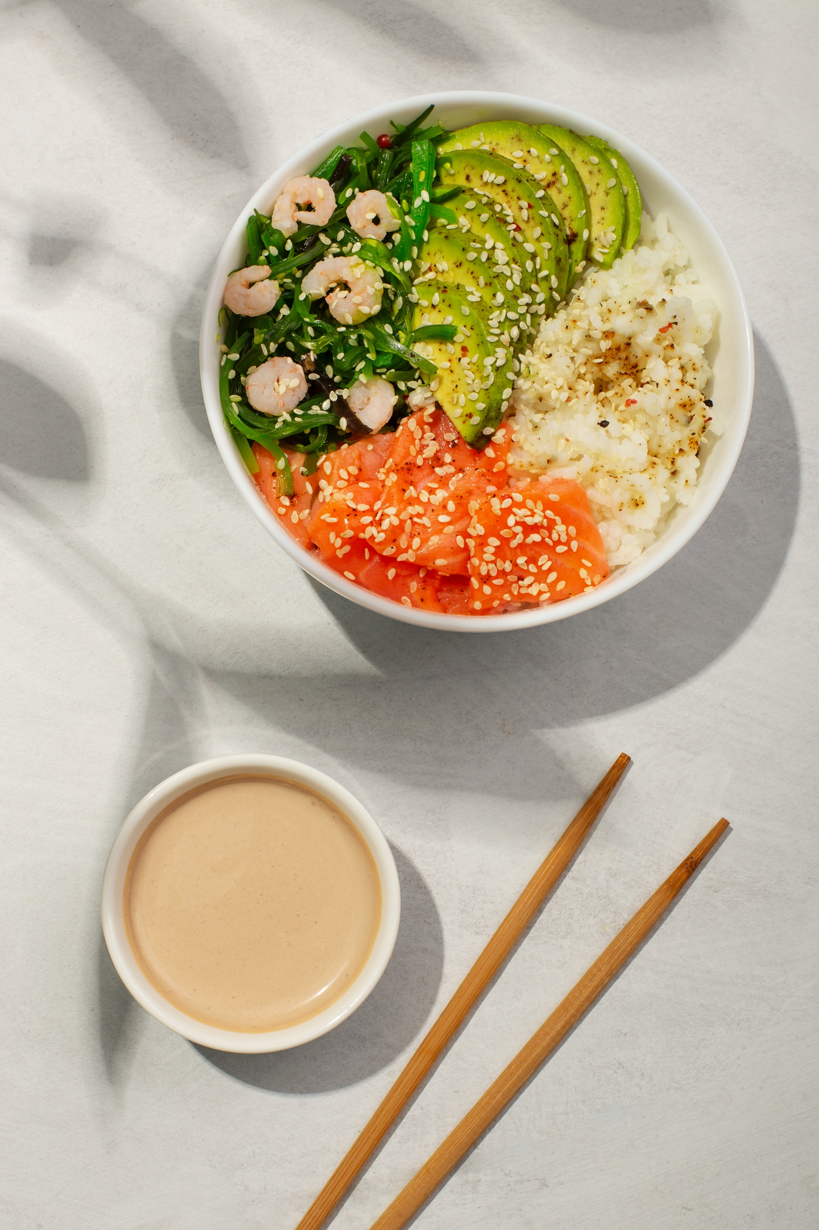
BUDDHA BOWLS - £16.00 per person
Minimum order 2 per item
SUPERFOOD PRAWN BUDDHA BOWL
Marinated king prawns, Quinoa salad with avocado & cherry tomato, Edemame & fennel salad with rocket
MEXICAN CHICKEN AVOCADO BUDDHA BOWL
Smoked paprika chicken breast, Wild rice salad with roast peppers, Rainbow slaw salad, sliced avocado
RAINBOW SALMON BUDDHA BOWL
Honey mustard grilled salmon, Rainblow slaw salad with new potatoes, Rocket salad with cherry tomato, Parmesan cheese & balsamic

Slide 15
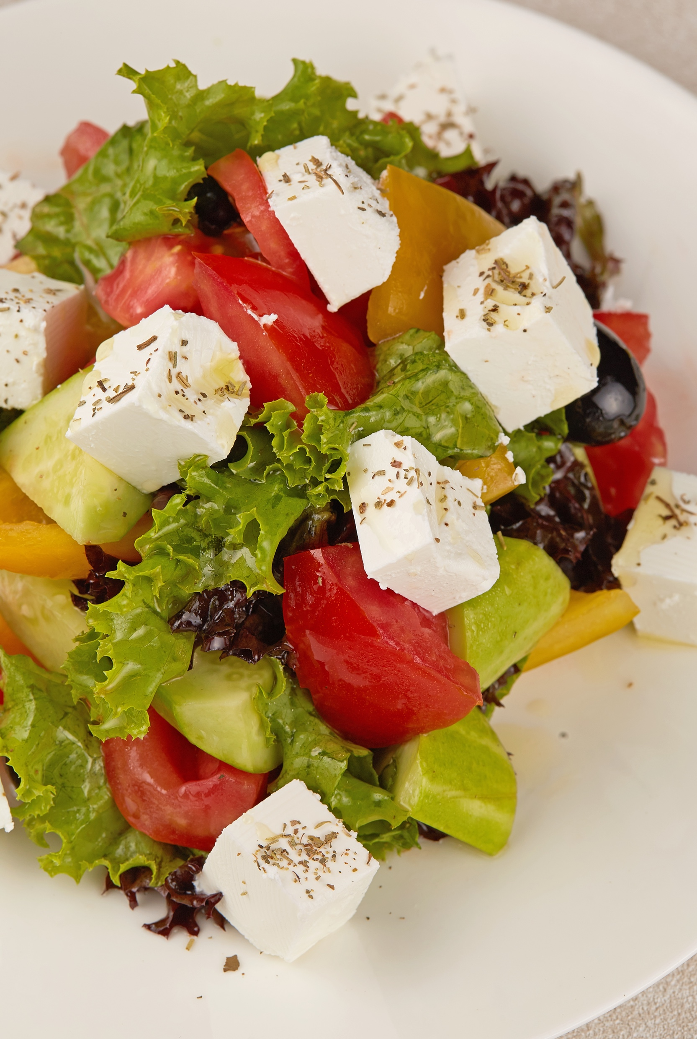
BUDDHA BOWLS - £16.00 per person
Minimun order 2 per item
SZECHUAN TOFU STIR FRY BUDDHA BOWL
Marinated grilled tofu with spicy peanut sauce, Szechuan mushroom & aubergine stir fry, Coconut lime rice and bak choy
GREEK HALLOUMI BUDDHA BOWL
Char grilled halloumi, Pearl cous cous salad with roast sweet potato & pomegranate, Marinated artichokes & Char-grilled courgettes, peppers & aubergines

Slide 16
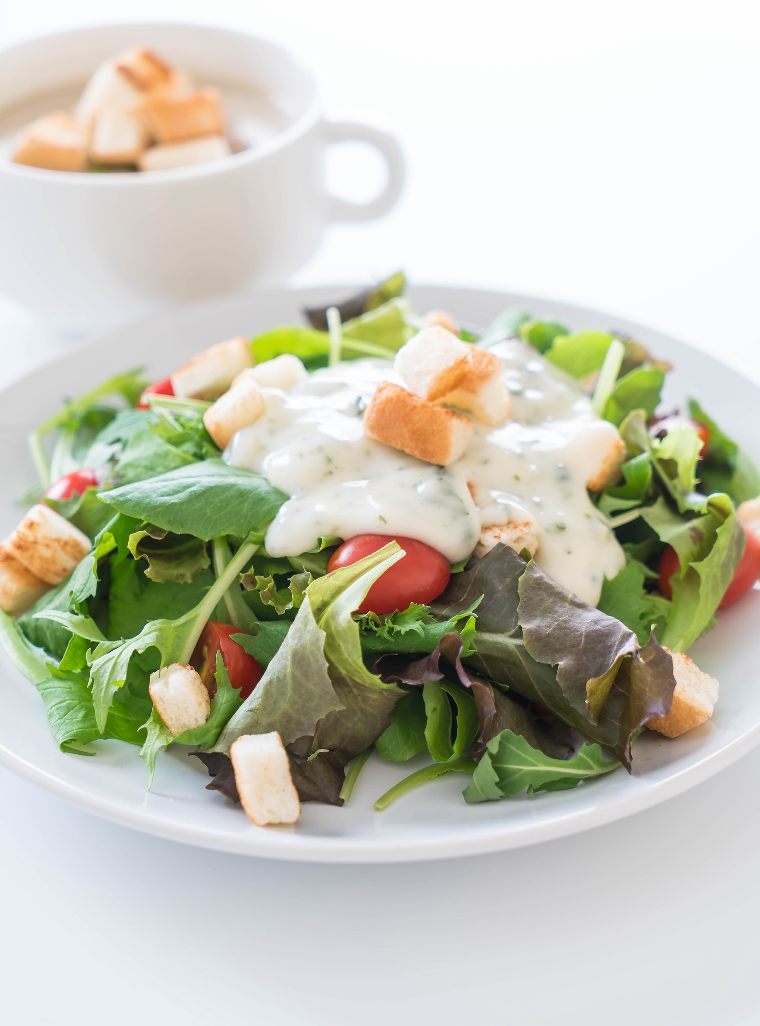
BOXED SALADS - £11.00 per box
ROAST CHICKEN BREAST AND AVOCADO GARDEN SALAD
Herb roast chicken breast, avocado, mixed peppers, tomato, cucumber and mixed leaves with balsamic olive oil dressing
CHICKEN CAESAR SALAD
Herb roast chicken breast, Romain lettuce, Parmesan cheese and crunchy croutons with creamy Caesar dressing
ROAST SALMON FILLET AND AVOCADO GARDEN SALAD
* £14.00 per box
Seasoned roast salmon fillet, avocado, mixed peppers, tomato, cucumber and mixed leaves with balsamic olive oil dressing
SUPERFOOD QUINOA SALAD
Quinoa salad with broccoli, yellow courgette, chickpea, carrot & crunchy walnuts

Slide 17
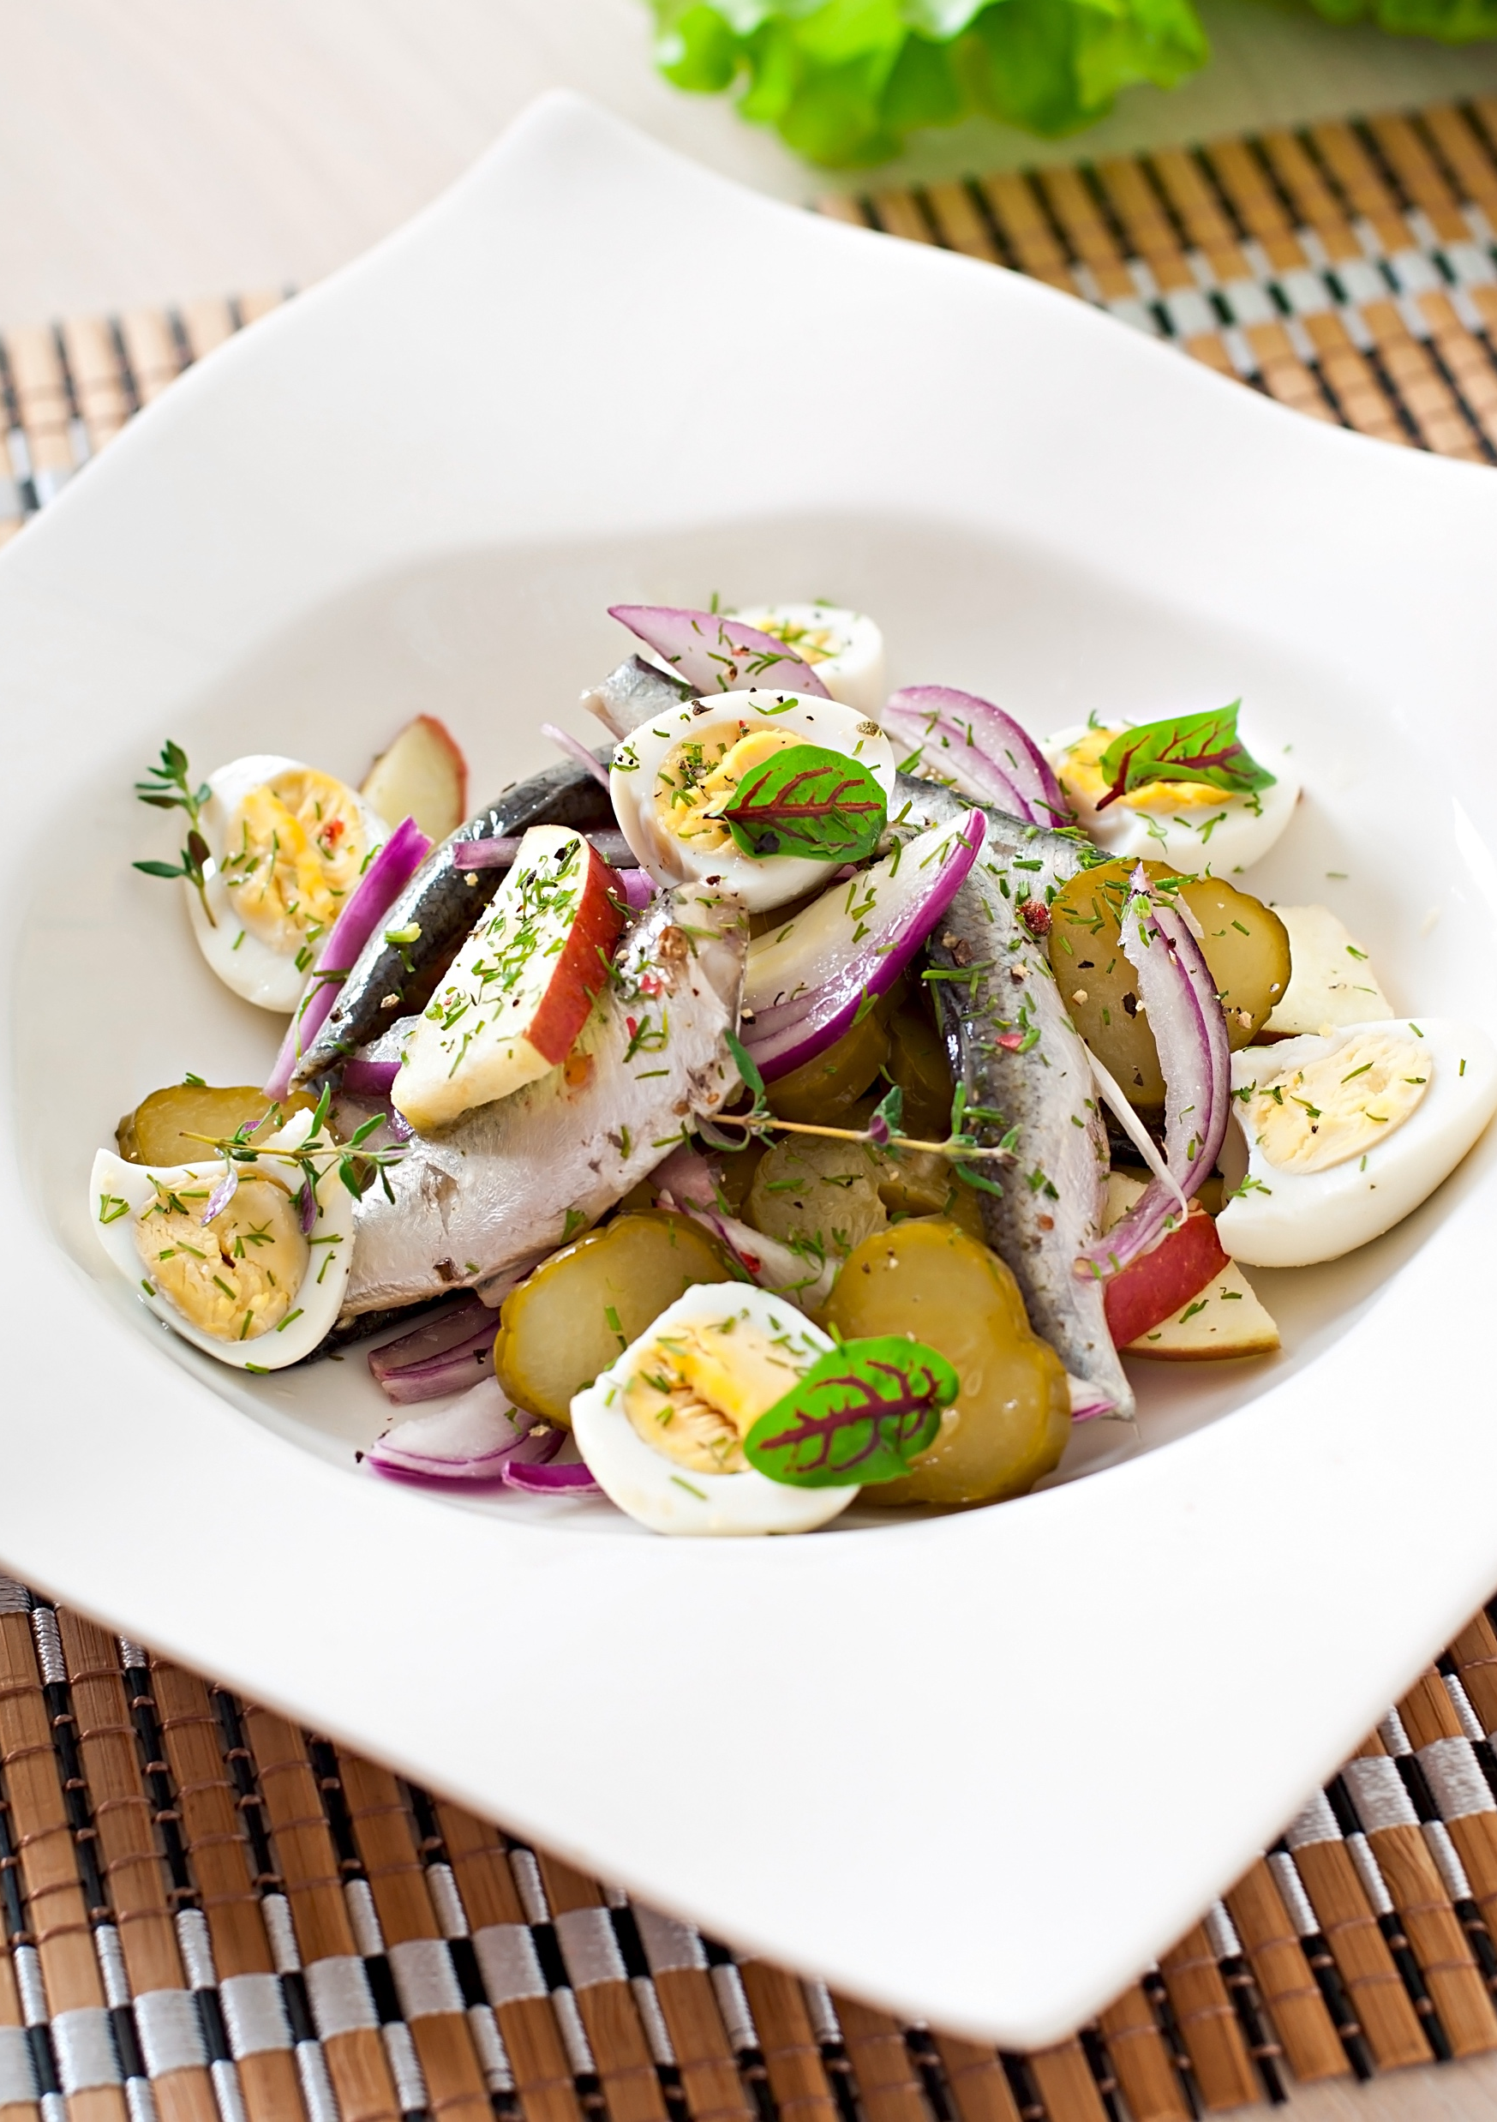
BOXED SALADS - £11.00 per box
VEG NICOISE SALAD
New potatoes, green beans, tomatoes, black olives, boiled eggs and crisp iceberg lettuce with French dressing
GREEK SALAD
Tomatoes, cucumber, feta cheese, black olives and houmous with toasted pita bread, garnished with fresh mint
PENNE PASTA PESTO SALAD
Penne pasta with basil & pinenut pesto dressing, cherry tomatoes, black olives and Parmesan shavings

Slide 18
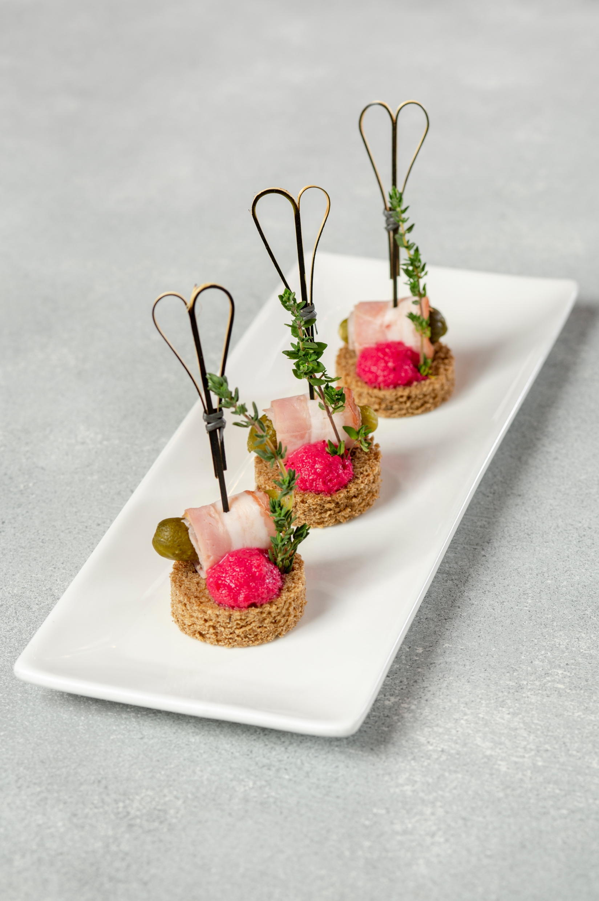
CANAPES / FINING DINING
£83.00 per set (serves 4)
Minimum order 4 sets (same menu)
*24 pieces each set
REGENT
Potato croquettes with smoked haddock aioli sun-blushed tomato (4) Pulled ham hock with grain mustard mayo & marinated apple sticks (4) Chargrilled aubergine roulades red pepper hummus & jalapenos (4) Smoked chicken, a hint of miso onion marmalade with pepper puree & nigella seeds (4) Chimichurri prawns pickled cucumber and guacamole (4) Marinated candied beetroot with onion relish and crushed pea and mint & black onion seeds (4)

Slide 19
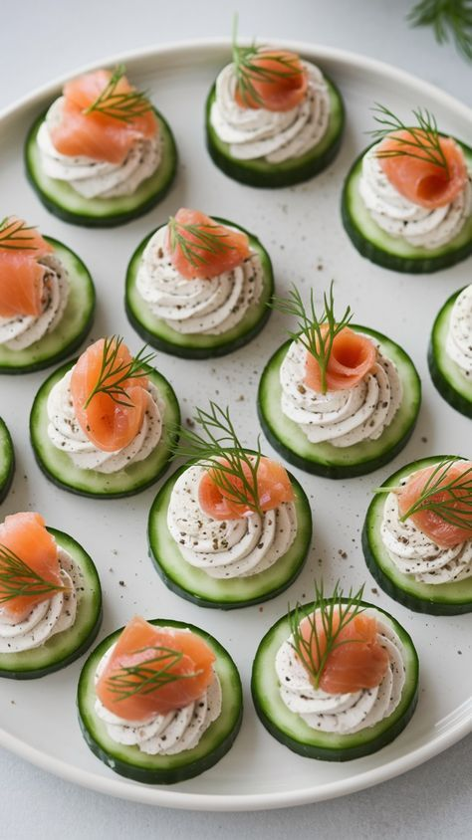
CANAPES / FINING DINING
£83.00 per set (serves 4)
Minimum order 4 sets (same menu)
*24 pieces each set
DULWICH
Thai crab and prawn cake with lime mayonnaise dipping sauce (4) Cauliflower pakora with pickled lime and minted yoghurt (4) Crisp tartlet of Parma ham with mascarpone and apple caviar (4) King prawn cocktail with marie-rose sauce and baby gem (4) Homemade mini yorkshire pudding with rare beef carpaccio and a creamy horseradish sauce (4) Goat’s cheese tossed in alfalfa served in a basil panier with sundried tomato (4)

Slide 20
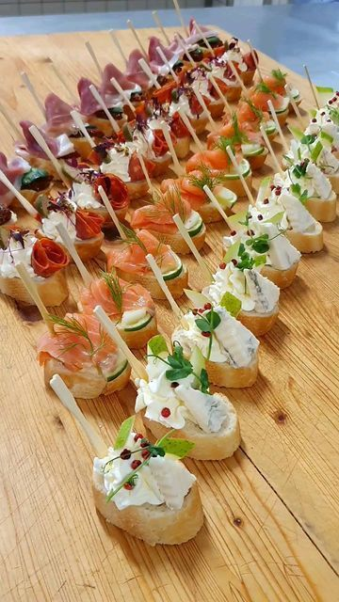
CANAPES / FINING DINING
£83.00 per set (serves 4)
Minimum order 4 sets (same menu)
*24 pieces each set
HAMPTON
Tamari marinated seitan roasted courgette tomato & red pepper glaze (4) Charcoal tart of hot smoked salmon, smoked salmon mousse and keta caviar (4) Marinated kohlrabi with a spiced tomato chutney vegan feta, radish mustard cress (4) Hawaiian chicken & pineapple skewers with a sweet chilly jam (4) Marinated Mulli rolls with crab meat ceviche style with lime & coriander (4) Massaman marinated tender Lamb with ratatouille pickled cucumber minted yoghurt (4)

Slide 21
CANAPES / FINING DINING
£83.00 per set (serves 4)
Minimum order 4 sets (same menu)
*24 pieces each set
SHOREDITCH
Bitter leaves gochujang marinated smoked tofu skewers with guacamole and black sesame (4)
Lemon marinated smoked mackerel with horse radish cream & fennel (4) Vegan plant-based bacon doused in maple syrup on a vegan cream cheese (4) Cajun spiced potato puff wrap in Parma ham red currant jam & crispy onion (4)
Tuna Nicoise, potato noisette, green beans, black olive, egg mayo & tomato pearls (4) Smoked duck with marinated fennel & fig chutney Boursin cheese & cilantro leaves (4)

Slide 22
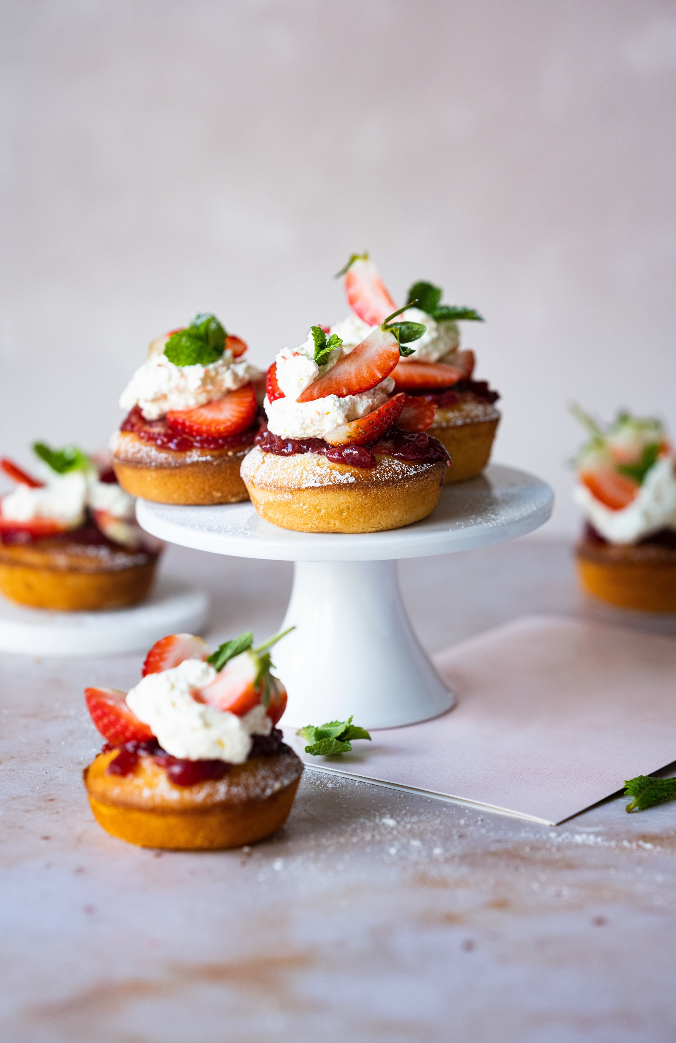
CANAPES (SWEET) / FINING DINING
£83.00 per set (serves 4)
Minimum order 2 sets (same menu)
*24 pieces each set
WIMBLEDON
Chocolate & pistachio nut profiterole Espresso pannacotta Eton mess Carrot cake Polenta & almond cake Portuguese Tart
HIGHGATE
Crème caramel Raspberry & coconut ice Pina colada Cural - sweet corn Brulee Ginger & Mandarin cake Mint Chocolate méringue lollipop

Slide 23
SWEET SELECTION - £60 per platter
BEST OF BRITISH DESSERTS PLATTER (SERVES 10)
Lemon drizzle
Cherry and almond
Victoria sponge
Fruit and nut
Jam and coconut
BROWNIE DESSERTS PLATTER (SERVES 10)
Classic Chocolate Brownie
Rich Chocolate Brownie
Fudge Brownie
Rockslide Brownie
CUPCAKES - £4.00 (PRICE PER PERSON)
A selection of delicious cupcakes fresh from our bakers.
Gluten free available on request
Vegan & Gluten Free Available On Request

Slide 24
SHARING PLATTERS - EACH
PLATTER SERVES 6 PEOPLE
ANTIPASTO PLATTER
Sliced Parma ham, stuffed piquillo peppers with cream cheese, bocconcini, sun-blushed tomato, spicy herb mixed olives with marinated chargrilled artichoke, aubergine, courgette, peppers and salad garnish.
Served with toasted ciabatta slices.
£77.00 per platter
MEDITERRANEAN PLATTER
Feta cheese, hummus, taramasalata, tzatziki, roasted onions drizzled with a pomegranate glaze, chargrilled marinated chicken fillet skewer, stuffed vine leaves and salad garnish.
Served with toasted pitta bread.
£80.00 per platter

Slide 25
SHARING PLATTERS - EACH
PLATTER SERVES 6 PEOPLE
KOREAN PLATTER
Panko breaded chicken strips, marinated beef bulgogi skewers, veg kimbap sushi rolls, steamed kimchee dumplings, marinated baby octopus, fresh kimchi, katsu sauce, dark soya sauce and pickled carrot & daikon radish salad.
£86.00 per platter
CHEESE PLATTER
Selection of continental cheese to include Brie, blue Stilton, smoked Applewood, mature Cheddar, Red Leicester, Emmental, and mini Bocconcini, with quince, celery sticks, mini gherkins, silverskin onions, grapes, dried apricots & walnuts. Served with savoury biscuits
£82.00 per platter

Slide 26
SHARING PLATTERS - EACH
PLATTER SERVES 6 PEOPLE
CHARCUTERIE PLATTER
Selection of sliced salt beef, chorizo, ham, sliced chicken, Milano salami and duck terrine with gherkins, silverskin onions, with mustard mayonnaise sauce and salad garnish Served with crispy crostinis
£80.00 per platter
BRAZILIAN PLATTER
Breaded chicken coxinha, bolinha de queijos (cheese balls), coxibe (minced beef & cheese croquettes), heart of palm skewers with cherry tomato & olives, bacalao (salt fish) crostini, served with creamy Aji green sauce and smoky tomato pepper salsa.
£86.00 per platter

Slide 27
WINE & BEERS
White
Pinot Grigio 23 Via Nova (Italy) £11.00
Sauvignon Blanc 2024 (New Zealand) £11.00
Oliver Tricon Chablis (France) £25.00
Fizz
Ruggeri Brut Argeo Prosecco (Italy) £15.00
Rose Via Vie Prosecco (Italy) £15.00
Red
Les Mougeottes Pinot Noir (France) £15.00
Ramon Bilbao Rioja (Spain) £19.00
Merlot Lanya 2023 (Chile) £12.00
Beer
Asahi (Osaka, Japan) £2.50
Peroni (Italy) £2.50
Peroni Zero £2.50
Brewdog IPA £3.30
Kentish Pip Crafstman Apple Cider £3.30
*Drinks are charged based on consumption.

Slide 28
ADD ON'S
Walkers Crisps - £1.10
Speciality Crudites & Hummus - £32.00 per platter (serves 8)
Olive Selection Platter - £43.00 per platter (serves 8)
Crackers & Bar Snacks - £40.00 per platter (serves 8)

